Slide 1
Flutter UI Challenges
Notes:
Revise the Task and tell them what’s better to do this task

Slide 2
Agenda
01
02
03
04
List View
Text Field
ToDo App
UI Examples

Slide 3
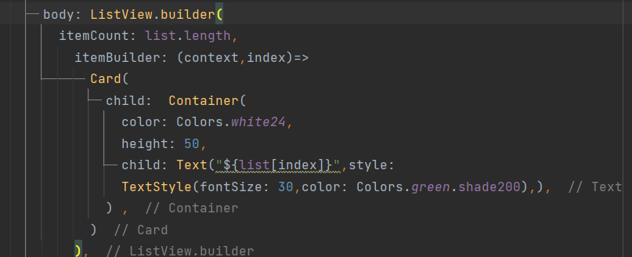
List View
A scrollable list of widgets arranged linearly.
ListView.builder :
The ListView.builder constructor takes an IndexedWidgetBuilder, which builds the children on demand. This constructor is appropriate for list views with a large (or infinite) number of children because the builder is called only for those children that are actually visible.

Slide 4
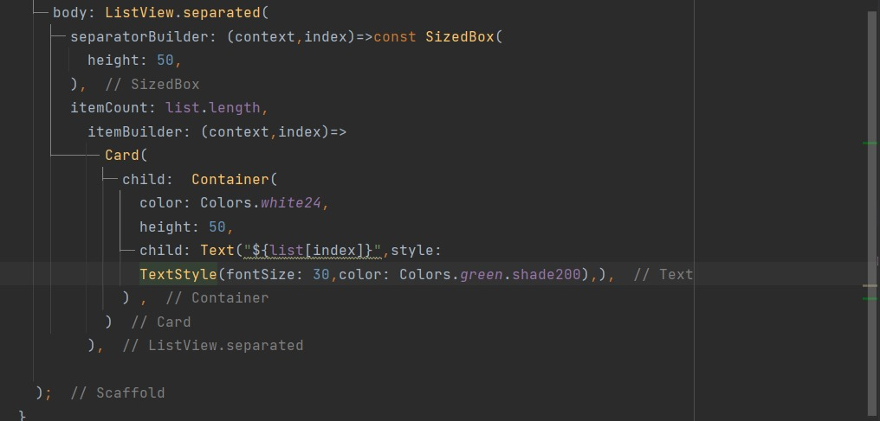
List View
A scrollable list of widgets arranged linearly.
ListView.separated :
The ListView.separated constructor takes two IndexedWidgetBuilders:
itemBuilder builds child items on demand,
separatorBuilder similarly builds separator children which appear in between the child items. This constructor is appropriate for list views with a fixed number of children.

Slide 5
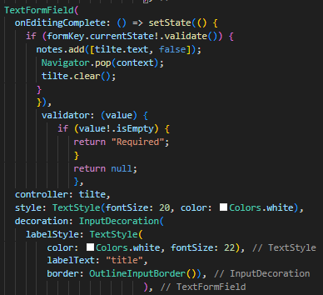
Text Field
The TextField widget is one of the fundamental UI components in Flutter, primarily used for capturing user text input.

Slide 6
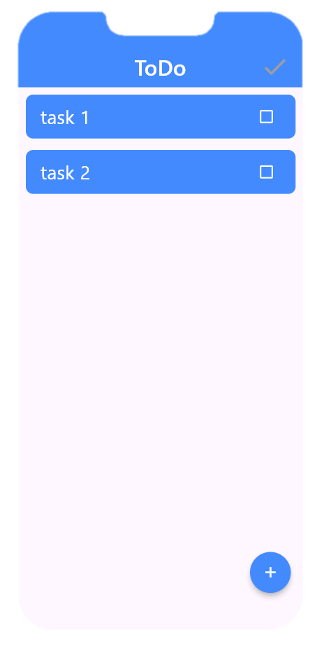
ToDO App

Slide 7
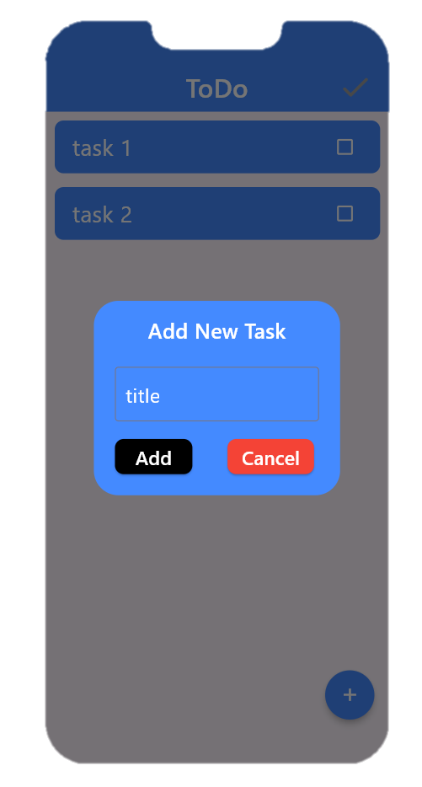
ToDO App

Slide 8
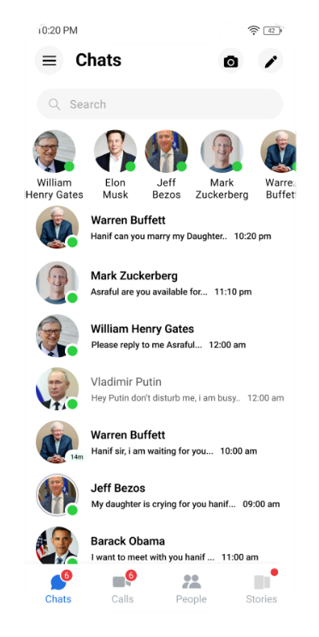
UI Exables

Slide 9
Thanks !
If you have any problem , send to me 😊

